Slide 1



Dynamic Architecture & Dynamic Software Programming Software Development with Intelligence
Haikuan Li, Visiting Professor
CLEBA Research, Delfgauw
The Netherlands
Haikuan Li, “Intelligent Dynamic Software Programming”, the 7th Online International Lecture Series of School of Software, Northwestern Polytechnical University, Xi'an China, 14-15/October/2022
Notes:
The title of the course is “Software Development Paradigm in the Era of Big Data”.

Slide 2
Reference
[1] Haikuan Li, “Intelligent Dynamic Software Programming”, the 7th Online International Lecture Series of School of Software, Northwestern Polytechnical University, Xi'an China, 14-15/October/2022
(2) Haikuan Li “Software Development of Datafication, Intelligence, Architecturalization and Intensification”, Lecture Notes for the Seminar on Leading Software Technology, Nankai University, Tianjin, China, Sept 2020
(3) Haikuan Li, Zhanqiu Dong and Yuanrui Wei, “Dynamic Software Programming”, Computer Engineering Design, 1989-2 **
(4) Claudius Gros, ”Complex and Adaptive Dynamical Systems”, Springer,4th ed. 2015
**李海宽,董占球,魏源瑞,“动态程序设计”计算机工程与设计,1989-2
Notes:
李海宽 董占球 魏源瑞 “动态程序设计”《计算机工程设计>, 1989-2
李海宽，“软件开发的数据化、智能化、架构化、集约化”, 课程讲稿，南开大学，天津，2020年9月

Slide 3
Intelligent Dynamic Software Programming 智能化的动态程序设计
Dynamic software programming is a new model for intelligent software development. In the era of software defined and internet of everything, most of our activities in software development will be dynamic software development or in other words, dynamic software programming. Programming in the traditional sense uses (static) program components to build systems; while dynamic software programming uses active components to build systems. The active components can be processes, running systems or any software defined things in runtime. The autonomous, uncertainty, dynamic, evolution, user inclusive and intelligent nature of these components constitute important features of dynamic software programming. Furthermore, the dynamic nature of the active components will allow the architecture of the system to change dynamically during runtime, resulting in so-called dynamic architectures. Dynamic architecture and active components are the basic elements of dynamic programming.
本章将讨论动态程序设计，一种新的智能软件开发模型。在这个软件定义与万物互联的时代，传统的程设计模式行将淡出，代之而起的是动态程序设计。传统意义下的程序设计以静态程序组件构建系统；而动态程序设计则以动态组件构建系统。动态组件可以是软件定义的任何事物，任何进程或正在运行的系统，这些组件的自主性、不确定性、动态演化性、用户包容性与智能化性质构成了动态程序设计的重要特征。此外，组件的动态特性将允许系统的架构在运行期间动态变化，从而产生所谓的动态架构。 动态架构与动态组件是动态程序设计的基本要素。

Slide 4
Process abstraction vs Function abstraction 数据抽象与函数抽象
数据抽象则过将数据封装在一个数据结构中来组织和管理数据，使得数据的组织和管理变得更加有效。Data abstraction organizes and manages data by encapsulating data in a data structure, making data organization and management more effective.
函数抽象涵盖了计算机程序中的一个特定功能，这样可以方便地重复使用。A functional abstraction covers a specific functionality in a computer program so that it can be easily reused.
数据抽象实现信息隐藏，函数抽象用来隐藏操作。 Data abstraction implements information hiding, and function abstraction is used to hide operations

Slide 5
Process abstraction abstract Computer 进程抽象抽象计算机
. 进程抽象: 由于进程有 一 个类似于数据抽象的内部 状 态和 一个操作集合 ，我们 可用进 程 抽象作为囊括数据抽 与函数 抽象的 概念。 Process abstraction: Since a process has an internal state similar to data abstraction and a collection of operations(or functions), we can use process abstraction as a concept that includes data abstraction and function abstraction.
与数据抽象不同的是进程抽象具有能独立决定操作执行顺序的控制 机构 , 并有一个外部对其资源进行同步存 取的 端 口和 存取 请求队列 。 请求的响应由进程 所决定 。Different from data abstraction, process abstraction has a control mechanism that can independently determine the execution order of operations, and has an external port and access request queue for synchronous access to its resources. The response to the request is determined by the process.
函数抽象抽象操作 , 数据抽象抽象变量 , 进程抽象抽象计算机[Wegner-84] 。 Function Abstraction Abstract Operation, Data Abstraction Abstract Variable, Process Abstraction Abstract Computer [Wegner-84]
。 随着并发的普遍化 , 进程抽象将成为中心的抽象机制 , 而数据抽象与函数抽象将被看作是进程抽象的特例。With the generalization of concurrency, process abstraction will become the central abstraction mechanism, while data abstraction and function abstraction will be regarded as special cases of process abstraction.

Slide 6
Dynamic Software Programming 动态程序设计
动态程序设计 是以进程为软件成分(components)的程序设计。
Dynamic programming is a software design strategy that considers processes as software components.
It involves designing programs that can adapt and change dynamically in response to changes in the environment.
This approach is well-suited for environments that are constantly evolving and requires software that can keep up with these changes.
李海宽 董占球 魏源瑞 “动态程序设计”《计算机工程设计>, 1989-2

Slide 7
Dynamic Software Programming 动态程序设计
动态程序设计作为软件开发的一个概念起源于 1989 年作为人工智能研究项目的一篇论文 [2]，当时我们认为智能系统化、可以由一组进程和它们之间的关系组成。
Dynamic (Software) Programming as a concept for software development was originated from a paper in 1989 as part of a research project on AI [2], when we considered that an intelligent system consists of a set of processes and the relationships between them.
Dynamic Software Programming is a new paradigm of software development, characterized by its integration, intelligence, autonomy, dynamic nature, evolution, and uncertainty. In this paradigm, systems are built using active components, which allows the system architecture to change dynamically during runtime, leading to dynamic architecture. This new approach brings new advantages and challenges to software development.
李海宽 董占球 魏源瑞 “动态程序设计”《计算机工程设计>, 1989-2

Slide 8
Dynamic Software Programming 动态程序设计
动态程序设计所谓动态程序设计实质上是不要求所设计的结果一定具有封 闭性、再现性与顺序性这些静态程序的固有特性。这使我们自然想到“进程”,这个已经用了很久,近似于经典的概念。
The so-called dynamic software programming does not require that the results of the programming must have the characteristics of the traditional programs such as closeness, reproducibility and sequence. This remind us "process", which has been used for a long time and is almost a classical concept.
动态程序设计是以进程为软件成分的进程程序设计,是主张应用与应用的具体实现相独立的程序设计.
Dynamic software programming is a style of programming in which processes are software component and the application in use is independent of its implementation
李海宽 董占球 魏源瑞 “动态程序设计”《计算机工程设计>, 1989-2

Slide 9
Dynamic vs Static Software Programming
静态程序设计 完全避开客观演变的环境,在静态环境下应用静态程序。这种策略以限制软件应用的时间和空间为代价, 虽然可行,却不足以解决软件危机中所面临的问题
Static software programming avoids the environment of objective evolution completely, and applies static programs in a static environment. This strategy is at the cost of limiting the time and space of software application, although it is feasible, it is not enough to solve the problems faced in the software crisis
动态程序设计 为适应客观变化的环境, 使软件具有一定的动态可适应性。 这不仅是可行的, 而且近年来关于程序设计的研究工作已为这一技术的发展奠定了基础。
Dynamic software programming In order to adapt to the objectively changing environment, the software has certain dynamic adaptability. Not only is this feasible, but research work on programming in recent years has laid the foundation for the development of this technology.

Slide 10
进程通讯 Process communication
进程通讯：对于进程的任意两次调用通讯,实际上是从一个一直前进的过程的两个不同点上去获取其运动中的结果或有关信息,而且一个进程可独立地接受外界影响。这便很难保证不同时间调用的一致性。
Process Communication refers to the exchange of information or results between two calls of a process.
It involves retrieving information from different points in a constantly evolving process.
One process can independently receive external influences, making it difficult to ensure consistency between calls made at different times.
The challenge in process communication is to ensure that the communication between processes is synchronized and that the information exchanged is accurate and consistent.
----李海宽 董占球 魏源瑞 “动态程序设计”《计算机工程设计>, 1989-2

Slide 11
进程的独立性Process Independence
进程的独立性：进程的独立性使其不属于任何调用者私有并转而成为整个进程社会的成员。
Process independence refers to the fact that a process is not owned by any particular caller but instead becomes a member of the entire process community.
This means that a process operates independently and has its own resources and memory space, making it separate from other processes.
This independence allows for processes to operate concurrently, increasing the overall efficiency of the system.
The concept of process independence is important for creating robust and scalable systems, as it enables processes to be isolated and managed independently of each other.
----李海宽 董占球 魏源瑞 “动态程序设计”《计算机工程设计>, 1989-2

Slide 12
自由进程与随动等式
自由进程: 所谓自由进程是指那些不被任何应用宣布短期或长期雇用的进程或曾被雇用但因为被解雇而正处于“失业”状态的进程.自由进程都是可再用的。
Free Process is a process that is not declared to be employed by any application either in the short or long term, or has been employed but is currently in an "unemployed" state due to being laid off.
随动等式: 类似于赋值语句,等号左边的量接受右边表达式的计算值。不同的是每当右边表达式中任何量的变化能使这一表达式的值发生变化, 则左边变量值将自动随着发生变化。
Dynamic equations are similar to assignment statements, but they automatically update the value of the left-side variable whenever any quantity in the right-side expression changes.
----李海宽 董占球 魏源瑞 “动态程序设计”《计算机工程设计>, 1989-2

Slide 13
动态程序设计进程的独立性 ----李海宽 董占球 魏源瑞 “动态程序设计”《计算机工程设计>, 1989-2
Appendix:
进程的独立性：进程的独立性使其不属于任何调用者私有并转而成为整个进程社会的成员。
Process independence refers to the fact that a process is not owned by any particular caller but instead becomes a member of the entire process community. This means that a process operates independently and has its own resources and memory space, making it separate from other processes. This independence allows for processes to operate concurrently, increasing the overall efficiency of the system. The concept of process independence is important for creating robust and scalable systems, as it enables processes to be isolated and managed independently of each other.
随动等式: 类似于赋值语句,等号左边的量接受右边表达式的计算值。不同的是每当右边表达式中任何量的变化能使这一表达式的值发生变化, 则左边变量值将自动随着发生变化。
自由进程: 所谓自由进程是指那些不被任何应用宣布短期或长期雇用的进程或曾被雇用但因为被解雇而正处于“失业”状态的进程.自由进程都是可再用的。

Slide 14
Dynamic Software Programming -- As a kind of Very High Level Programming
Dynamic (Software) Programming as a concept for software development was originated from a paper in 1989 as part of a research project on AI [2], when we considered that an intelligent system consists of a set of active components and the relationships between them. The behaviors of an active components may have natural intelligence or artificial intelligence.
Dynamic programing is a kind of very high-level programming based on dynamic architectures and active components, which can be defined constructively as follows,
Active components can be processes, services or any software defined things in running status, such as software defined web services, mobile, PC, taxi, doctor etc. Obviously, an active component consists of software, hardware, as well as the people behind it for operation and maintenance.
HLI20130425 - Chapter 0.0
System ::= Architecture + Active Components

Slide 15
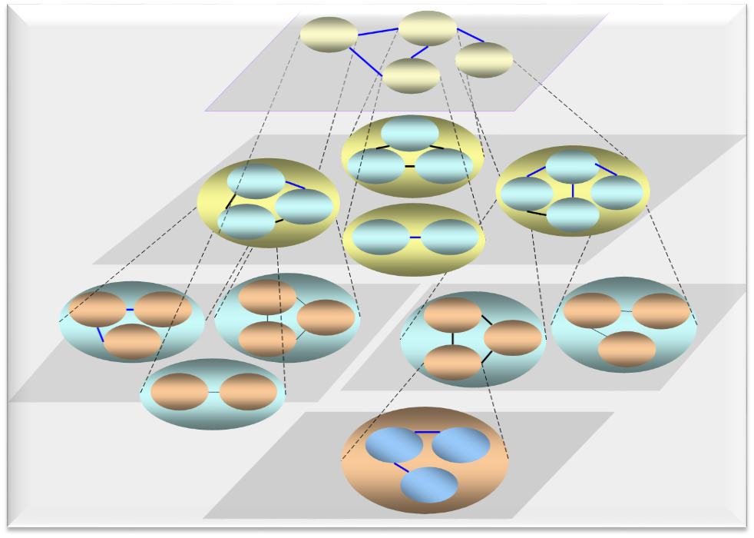
Service-Oriented Architecture
A service-oriented architecture is an architectural pattern in software design in which application components provide services to other components via a communications protocol, typically over a network.
The principles of service-orientation are independent of any vendor, product or technology [Msdn.microsoft.com].
Services are loosely coupled units of functionality that are self-contained [wiki]
Service
Service
Service
Service
Service
…
Service
From abstraction point of view, SOA (service-oriented architecture) consists of a set of services and the relationships between them.

Slide 16
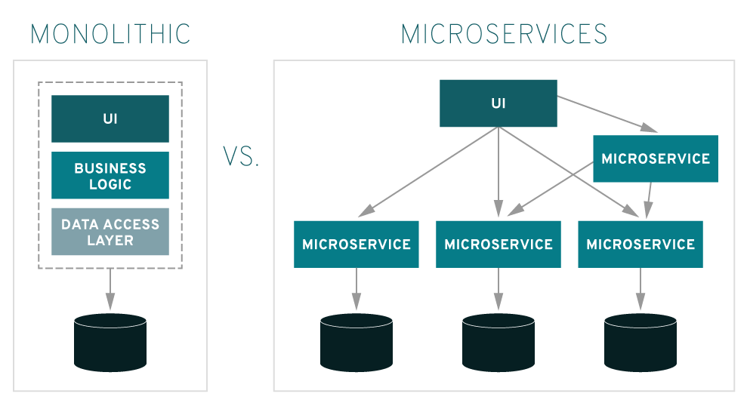
Microservice architecture
Microservice architecture – a variant of the service-oriented architecture (SOA) structural style – arranges an application as a collection of loosely-coupled services. In a microservices architecture, services are fine-grained and the protocols are lightweight [wiki].
In 2014, Martin Fowler & James Lewis, introduced the concept of microservices, defining them as small services composed of a single application with its own processes and lightweight processing, which are designed according to business functions, deployed in a fully automated manner, and communicate with other services using HTTP APIs. At the same time the service will use a centralized management (e.g. Docker) capability at minimal scale, and the service can be implemented in different programming languages and components such as databases - https://microservices.io/， https://martinfowler.com/articles/microservices.html

Slide 17

Advantages of Microservices
Microservices Are Easier to Build and Enhance
Microservices Are Easier to Deploy
Microservices Are Easier to Maintain, Troubleshoot, and Extend
Microservices Simplify Cross-Team Coordination
Microservices Deliver Performance and Scale
Microservices Simplify Real-Time Processing

Slide 18
Dynamic Architecture 动态架构
“Dynamic Architecture refers to the software architecture of a software system with rules of evolution of its structure /architecture during runtime. The system’s components and connections can be created and destroyed during runtime according to the rules from design-time†. ”
Marek Rychly, “Dynamically Reconfigurable Architectures: An Evolution of Approaches for Preventing Architectural Violations”, Handbook of Research on Architectural Trends in Service-Driven Computing, © 2014 |Pages: 18,DOI: 10.4018/978-1-4666-6178-3.ch002

Slide 19
Static vs Dynamic Architecture 静态架构和动态架构
Static architecture is represented by a collection of components that are structured in a component hierarchy. For each component in the hierarchy, its component implementation defines the internal structure in terms of subcomponents and interactions in terms of connections .**
“Dynamic architecture is represented by a collection of component and connection configurations that are controlled by modes. Modes effectively represent operational modes and fault tolerant configurations of both software and hardware, as well as modal behavior of individual components.”**
** Mark Richards, “Software Architecture Patterns”, ebook, https://www.oreilly.com/library/view/model-based-engineering-with/9780133132922/ch09.html, Jan. 2022.

Slide 20
Dynamic Architecture vs Microservice Architecture
System::=Microservices Architecture + Services
Microservice architecture(MA) – a variant of the service-oriented architecture (SOA) structural style – arranges an application as a collection of loosely-coupled services.
Dynamic architecture(DA) is represented by a collection of component and connection configurations that are controlled by modes. Modes effectively represent operational modes and fault tolerant configurations of both software and hardware, as well as modal behavior of individual components.
Difference: MA aims at service implementation in a loosely coupled way, while DA aims at construct a new system by reusing existing services and software defined things. MA emphasize the way of service implementation, while DA focus ony the functionality and behaviors of the services.

Slide 21
Active components vs Static Component 动态组件与静态组件
Active components are system components in runtime, which provide services to and have interconnections with other runtime system components. Typical examples of active components are processes in operating system and services in internet, microservices in an integrated system or any software defined things in running status.
An active component may consist of software, hardware, database and other supporting environment including even the people for maintenance and operation.
In contrast，the software components that are not in runtime such as source code components are called static components.

Slide 22
Processes as Active Components
What: In computing, a process is the instance of a computer program in runtime. It contains the program code and its activity.
Difference: Process vs Program While a computer program is a passive collection of instructions; a process is the actual execution of those instructions.
Long-life process: How about when the program is a large system and its life-cycle is long, e.g. days, weeks, years, or a few decades.
Process as a system component: A system consists of a set of processes that may have short or long life-cycle and with interconnection between them.
Software defined things: A processes may be connected with outside world and simply presents a software defined thing.

Slide 23
Services as Active Components
Service-oriented architecture (SOA) is an architectural style that supports service orientation.[1] over a network.
A service is a discrete unit of functionality that can be accessed remotely and acted upon and updated independently[2],
In service-oriented architecture, the functionalities may be provided between the application components through a communication protocol over a network [2].
[1] "SOA Source Book - What Is SOA?". collaboration.opengroup.org. Retrieved March 30, 2021.
[2] "Chapter 1: Service Oriented Architecture (SOA)". msdn.microsoft.com. Archived from the original on July 7, 2017.

Slide 24
Software Defined Thing as Active Components
Software Defined Anything (SDx) is the concept of having a virtualized computing infrastructure or anything in real world that is completely virtualized. In this manner, the infrastructure or the thing can be delivered to customers as a service, or becomes a runtime component of a software system，e.g.,
Software-defined printer,
Software-defined shop,
Software-defined taxi,
Software defined computer (Operating System)
Software defined person ( e.g. doctor in internet) [wiki]

Slide 25
Internet of Things as Active Components
Internet of things (IoT) facilitates billions of devices (or anything in the real world) to be enabled with network connectivity to collect and exchange real-time information for providing intelligent services. Thus, IoT allows connected devices (or anything in the real world) to be controlled and accessed remotely in the presence of adequate network infrastructure.
S. Bera and etal ,Software-Defined Networking for Internet of Things: A Survey, IEEE internet of things journal, vol. 4, no. 6, dec. 2017

Slide 26
Examples of Active components
Modern applications, e.g., for pervasive(普适) computing scenarios, are increasingly reliant on systems built from multiple distributed components, which must be suitably composed to meet some specified functional and non-functional requirements.[1]
Ambient (周围环境) intelligence or intelligent transportation systems, consist of several (from tens to thousands) services that cooperatively contribute to the achievement of some common goal.[2]
Caporuscio, M., Grassi, V., Marzolla, M., Mirandola, R.: GoPrime: a fully de-centralized middleware for utilityaware service assembly. IEEE Transactions on Software Engineering 42(2), 136152 (2016)
S. Schuhmann, K. Herrmann, K. Rothermel, and Y. Boshmaf. Adaptive composition of distributed pervasive applications in heterogeneous environments. ACM Transactions on Autonomous and Adaptive Systems (TAAS), 8(2):10:1–10:21, July 2013.

Slide 27
Service Discovery and System Discovery
Service discovery is the process of automatically detecting devices and services on a network. Service discovery protocol (SDP) is a networking standard that accomplishes detection of networks by identifying resources.
Reusability: An often forgotten but great benefit of microservices is the fact that the independent components (processes) that make up the entirety of the software can be reused for future projects.
System Discovery is a process of automatically detecting a system by identifying a set of interrelated active components and the relationships between them with regarding to a business goal of an application domain. The systems to be recovered can be, for examples, a supply chain, a business process or an undiscovered organization
SCaporuscio, M., Grassi, V., Marzolla, M., Mirandola, R.: GoPrime: a fully de-centralized middleware for utilityaware service assembly. IEEE Transactions on Software Engineering 42(2), 136152 (2016)

Slide 28
The Types of Service Discovery
Client-Side Service Discovery is a type of service discovery, the service client or consumer has to search the service registry in order to locate a service provider. Then, the client selects a suitable and free service instance through a load balancing algorithm to make a request, e. g. Eureka.
Server-Side Service Discovery is a type of service discovery, the client or consumer does not have to be aware of the service registry. The requests are made through a router, which then searches the service registry itself. When the router finds a valid service instance that is available, it forwards the request and gets the job done , e. g. NGINX, AWX
SCaporuscio, M., Grassi, V., Marzolla, M., Mirandola, R.: GoPrime: a fully de-centralized middleware for utilityaware service assembly. IEEE Transactions on Software Engineering 42(2), 136152 (2016)

Slide 29
Service Discovery in Microservice Architecture
HashiCorp Consul is primarily a tool to discover and configure services. Its API allows clients to register and discover service instances, and it also performs regular health checks to ensure service availability
Controlling the distributed data plane to provide a scalable and reliable service mesh(网).
Providing a real-time directory of all running services.
Automating centralized network middleware configuration to reduce human intervention.
Automating lifecycle management of certificates issued by third-party Certificate Authority.
Enabling visibility in services and their health status.
Providing unified support across difArchiferent workload types and runtime platforms.

Slide 30


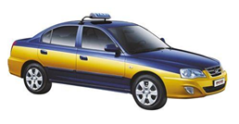





Software Development with Everything
Printer
Radio
Computer
Teacher
Doctor
People
Shop
Company
……

Slide 31

Gold Mine
Active Software Resources
The Resources for
Dynamic Programing
Software Defined Everything
Internet
Services
Static
Software Resources
Internet of
Everything
Mobile Internet

Slide 32
From Static to Dynamic Programming
Program ::= Instructions & Relations between them
Program ::= Sentences & Relations between them
System::= Static Components & Relations between them
System::= Active Components & Relations between them
Active Component ::= Process, Service, Living Agent and any software defined thing in running status.

Slide 33
Network-Based Dynamic Programming
Network Style Architecture：Programming with reusing a set of active software resources dynamically with network style architecture, resulting a network style system.
Active Component: An autonomously running software component that provides service or communicates with other components, e.g. web services and CPS (Cyber Physical Systems).
Network Style Architecture
+ Active Components
= System

Slide 34
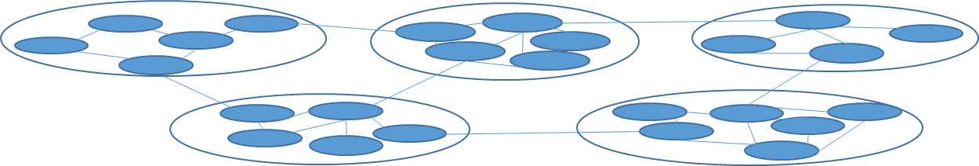
Cluster Style System Development
Active Components: A System consists of a set of active components that are services or any software defined things in internet, such as web services, mobile, PC, taxi, doctor etc.
Cluster : A cluster consists of a set of active components and the interconnection between them, forming a piece of network. The components inside a cluster are high coherent and the connection between clusters are loosely coupled.
Network Style Architecture: A system consists of a set of clusters, that is implemented via the interconnection between the components of different clusters.

Slide 35
Dynamic Programming
Dynamic Programming: System Construction with active components. In other words, a system consists of a set of active components and the interconnections between them, namely,
System ::= Architecture + Active Components
Cluster Style Dynamic System Architecture

Slide 36
Intelligent Components
An intelligent component is an active component with AI or NI behind, which are characterized by multiple features as following:
Autonomous: The system components are active components that are running in advance autonomously.
Implementation Independency: The implementation of system components is hided from the system. Every system component is a black box used for system development.
Integration: An running software component may be an integration of a set of lower-level components or complex logics.
Dynamics: A component may join or withdraw from the system dynamically.
Evolution: The quality of the components may be evolving dynamically so that to be adaptive to changing business and technical environment.
Uncertainty: The status of the component with uncertainty.
User Inclusive: The users can be software defined things or active components of the system.
Intelligence: The components may have natural or artificial Intelligence behind.

Slide 37
The Features of Dynamic Programming
Autonomous: The system components are active components that are running in advance autonomously.
Implementation Independent: The implementation of system components is hided from the system. Every system component is a black box used for system development.
Integration: An running software component may be an integration of a set of lower-level components or complex logics.
Dynamics: A component may join or withdraw from the system dynamically.
Evolution: The quality of the components may be evolving dynamically
Uncertainty: The status of the component with uncertainty.
User Inclusive: The users can be software defined things or active components of the system.
Intelligence: The components may have natural or artificial Intelligence behind.

Slide 38
Dynamic Architecture 动态架构
“Dynamic Architecture refers to the software architecture of a software system with rules of evolution of its structure /architecture during runtime. The system’s components and connections can be created and destroyed during runtime according to the rules from design-time†. ”
Marek Rychly, “Dynamically Reconfigurable Architectures: An Evolution of Approaches for Preventing Architectural Violations”, Handbook of Research on Architectural Trends in Service-Driven Computing, © 2014 |Pages: 18,DOI: 10.4018/978-1-4666-6178-3.ch002

Slide 39

autonomous
Description: In dynamic programming, the system components are running autonomously. The decisions about their behaviors are made by themselves.
Example： Though a service consumer may request a service from a service provider, it is the service provider who makes final decision about what service to be provided in what time and in what cases. The service provider is therefore considered as an autonomous component.

Slide 40
Dynamics
Description: System components may join or withdraw from the system during runtime.
Example: A PC of a Pear to Pear network may be on or closed any moment; a taxy driver may on or off duty any moment, a member of a WeChat group may be on line or off line any moment.

Slide 41
Evolution
Description: The software architecture and components of a system may be evolved continuously and dynamically during system runtime, regarding to functional or non-functional quality.
Example, you may take any services of internet as software components of your system while the services may be evolving continuously. For example, the functionality and performance of the search engines or language translators in internet are continuously updated, regarding to the algorithms, databases as well as the format and content of their input and output. These changes may be coursed by maintenance or learning mechanism in use.

Slide 42
Uncertainty of Architecture & Components 架构和组件的不确定性
Description: In Dynamic Programming, the status of the software architecture and components are with uncertainty.
Because of dynamics, evolution and autonomy of the system components, the system may have uncertainty in status, while providing stable service is often the target of the system. Dealing with uncertainty of a system is important to provide stable services.
Nevertheless, not all uncertainty are necessarily negative points. For example, in according to updating the components, the system may be gradually evolved into better quality and more intelligent one. For example, Google's search engine and language translation have been improved dramatically in the last few decades.

Slide 43
Architectural Evolution 架构演化
Architectural evolution in building: architectural style evolved into something much more graceful through the Byzantine and Romanesque periods. It was during 527 – 1200 that the majority of architecture began to use brick instead of stone, changing forever the way that buildings would be constructed[2].”
Architecture evolution in software is the process of maintaining and adapting an existing software architecture to meet changes in requirements and environment. ... As such, architecture evolution is concerned with adding new functionality as well as maintaining existing functionality and system behavior[3].
Dynamic Architectural type Evolution enables an architecture to change entirely its specification duing runtime, by introducing new architectural element types and connections or by modifying the type and the running instances of its architectural elements [4].
[2] RG Group, Whitepaper: How has architecture changed over time and what could this look like in the future? RG Group, UK, June 2019. [3] Wiki, , https://en.wikipedia.org/wiki/Softwarearchitecture [4] C. Costa-Soria & et al, “Managing Dynamic Evolution of Architectural Types”, Lecture Notes in Computer Science book series (LNCS, volume 5292)

Slide 44
Uncertainty: Component Mutation 不确定性 组件变异
Component mutation refers to the changes of the component during the runtime. This is because a system's component evolves during the runtime according to the actual state of the system's environment. For example, a process or service with learning mechanism.
Component mutation may have positive or negative impact to the performance and functionality of the component.
The component mutation may have also impact to the components connected in the system and therefore cause system mutation.

Slide 45
Uncertainty: Architectural Mutation 不确定性: 架构变异
A system's architecture evolves during the runtime according to the actual state of the system's environment, and consequently, runtime reconfigurations may eventually lead to incorrect architecture configurations that were not considered during the system's design phases. [1]
These architectural violations are known as architectural erosion or architectural drift (or architectural mutation) and they contribute to an increasing brittleness of the system, or a lack of its coherence and clarity of its form. [1]

Slide 46
Learning-Based Dynamic Architecture
Dynamic architecture is an active artifact that is changing dynamically along with system running. The organizational structure of the system may not be suitable to the system any more during runtime. Dynamic rearchitecting is therefore necessary.
Learning-Based Dynamic Architecture is the organizational structure of a system, which is dynamically rearchitected based-on a learning mechanism so that to maintain the suitability of the architecture.

Slide 47
Architecture with Status(???)
A dynamic architecture consists of a set of elements, including active components and the relationships between them. The elements may have status such as added, removed and weight that have impact to the organizational structure of the system.
Registered
Added refers to a newly joined system element.
Removed refers to a system element that is withdrawn from the system.

Slide 48
User Inclusive
User Inclusive: In the case of dynamic programming, the traditional users of a system may become software defined things, as active components of the system.
For example, the members of a WeChat group or the taxis of DiDi Taxi System, they are software defined things and therefore the system components. Moreover, you may take passengers as system components as well, especially when the passengers are asked to play a role to improve system services.

Slide 49
Software Defined Users
Alibaba: Web service, Software defined Seller and Buyer
DiDi Taxi: Web service, Software defined Taxi and Passengers
Tiktalk：Web service, Software defined Video Provider, Video and Viewer
Pinduoduo： Web service，Seller, Buyer，Buyer Group
WeChat： Web Service，User，User group
Web Service
Web Service
Seller
Buyer
Vidieo Provider
Video
Viewer
User Group

Slide 50
Intelligent
Description: The system developed in terms of dynamic programming are normally intelligent, this is because the active components forming the system may have natural or artificial intelligence.
AI Technology: In the era of AI, more and more active components may contain AI technology and have intelligent behaviors;
User Inclusive: As the system are user inclusive, the users can be software defined things, namely active components that have nature intelligence.
Maintainers and operator behind. Moreover, behind many active components there are man maintainers and man operators who run and change the components in an intelligent way.

Slide 51
Dynamic Programming
Service Discovery
Service Selection
Service Level Agreement
Real time Service
Uncertainty
Replacement

Slide 52
Dynamic Modeling
“Information systems are designed and implemented in a rapidly changing and turbulent environment. ” Henk G. Sol, 1991
“The philosophy of dynamic modelling, he wrote, aims at the improvement of staff performance by creating an environment which supports problem solving processes.
“The modelling method should stress the specification of conceptual and empirical models for better understanding of existing situations and possible alternative solutions.
“The modelling should be based on possible changes in task structures and working processes, and on an effective application of technology.
Reference: HG Sol, and P. Bots, editors, Proceedings of the Fourth International Working Conference on Dynamic Modelling and Information Systems, pages 53-69. Delft University Press, 1994.

Slide 53
Dynamic software development Towards continuous growth
“The dynamic nature of knowledge and software evolution and usage present a pervasive challenge to system developers. Discrete attempts to create such systems often lead to a mismatch between system, expectation and a changing reality. The rationale for a Dynamic Feedback Model stems from the need to focus on a continuous and long-term perspective of development and growth in change-intensive environments. We make the case for a learning and knowledge-driven view of software development and present such a model in a way that accounts for the long-term survival, growth and evolution of software-intensive systems.” – D. Dalcher, 2003
Reference: Dalcher, Darren, “Dynamic systems development : Towards continuity, growth and evolution”. Procs of 10th IEEE Int. Conf. and Workshop on the Engineering of Computer-Based Systems: ECBS 2003. ed. / S. Kawada. LOS ALAMITOS : IEEE COMPUTER SOC, 2003. p. 62-71

Slide 54
Dynamic Programming as terminology
Dynamic Programming as terminology used in this lecture note refers to a kind of computer programming, namely, the process of designing and building an executable computer system to accomplish a specific computing result or to perform a specific task. One must distinguish the term used in this lecture note from either the same term used in mathematics or as an algorithm even in computer programming.

Slide 55
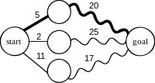
Dynamic Programing in Mathematics
In terms of mathematical optimization, dynamic programming usually refers to simplifying a decision by breaking it down into a sequence of decision steps over time[wiki]
For example, finding the shortest path in a graph using optimal substructure; a straight line indicates a single edge; a wavy line indicates a shortest path between the two vertices it connects (among other paths, not shown, sharing the same two vertices); the bold line is the overall shortest path from start to goal.

Slide 56
Dynamic Programing as an Algorithm
Dynamic Programing is also refers to a kind of algorithm in computer programming, which was developed by Richard Bellman in the 1950s and has found applications in numerous fields, from aerospace engineering to economics.
The algorithm is featured by simplifying a complicated problem by breaking it down into simpler sub-problems in a recursive manner.
Cormen, T. H.; Leiserson, C. E.; Rivest, R. L.; Stein, C. (2001), Introduction to Algorithms (2nd ed.), MIT Press & McGraw–Hill, ISBN 0-262-03293-7 . pp. 344.

Slide 57
Dynamic Programming as a language feature

Slide 58
The Development of Dynamic Programing
1989 - H LI, Z Dong & Y Wei, “Taking the dynamically featured processes (rather than programs) as the software components so that to improve software development and maintenance via the dynamic reusability of the processes.” [1]
1996 - WR Schulte, YV Natis (Gartner), “A service-oriented architecture is a style of multitier computing that helps organizations share logic and data among multiple applications and usage modes …“[2]
2014 - M Fowler & J Lewis. ”Defining microservices as small services composed of a single application with its own processes and lightweight processing, …” [3]
Haikuan Li, Zhanqiu Dong and Yuanrui Wei, “Dynamic Programming”, Computer Engineering Design, 1989-2
W. Roy Schulte, Yefim V. Natis, Gartner, "Service Oriented” Architectures, Gartner, SPA-00-7425SPA-401-068SPA-401-070SPA-401-167SPA-ARCH-259SPA-200-126, 12 April 1996
Martin Fowler & Jimes Lewis, “Microservices” , Martin Fowler. 25 March 2014, www.martinfowler.com

Slide 59

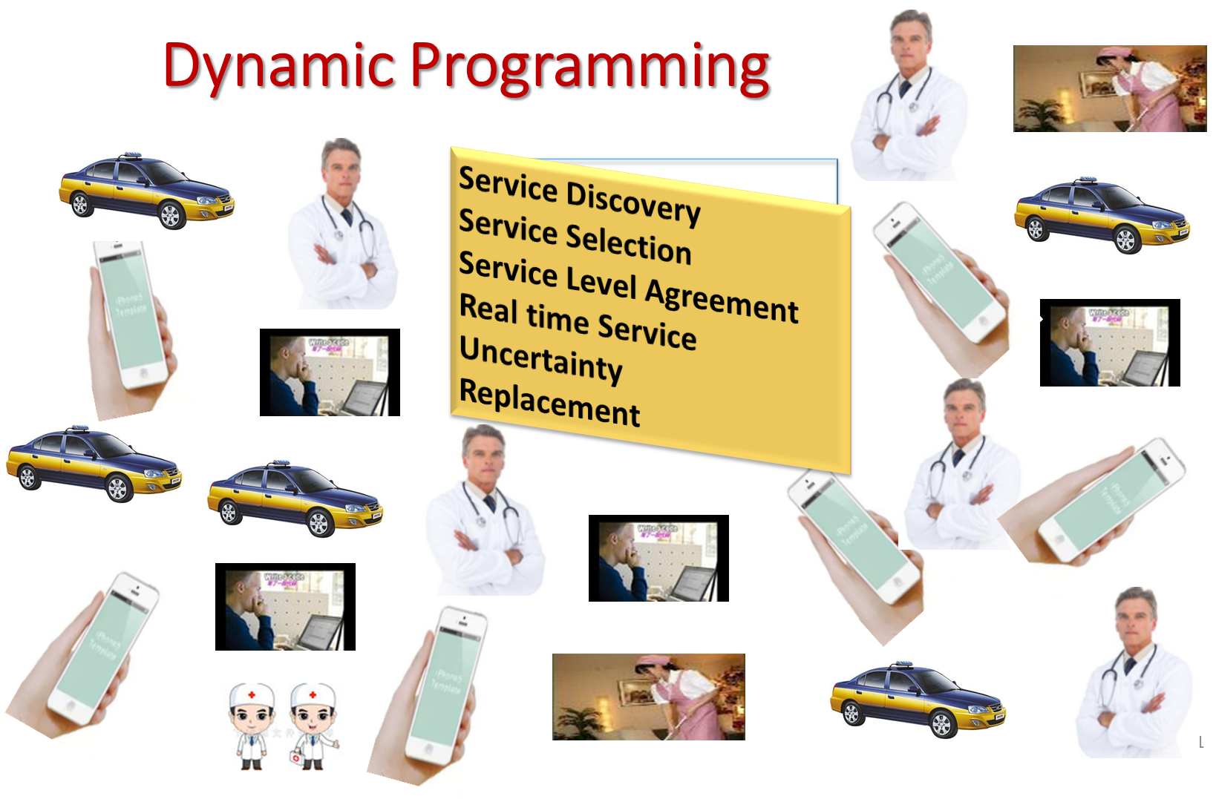
Q&A

Slide 60
Q&A: Dynamic Software Programming
What is dynamic Computer Programming?
What is static Computer programming?
What is the difference between dynamic computer programming in this lecture and that of in mathematics?
Is Dynamic programming a very high-level programming?
What is the difference between dynamic computer programming and static computer programming?
What are the active components for dynamic computer programming as defined in this lecture.
Wat is dynamic architecture?
What a formula is in this lecture to describe dynamic computer programming?
What are the 8 properties of dynamic computer programming?

Slide 61
The History of Dynamic Programming
Dynamic Programming as a concept for software development was originated from a paper in 1989 as part of a research project on AI. We consider an intelligent system as a set of active components (processes) and the relationships between.
Background: In computer science, communicating sequential processes (CSP) is a formal language for describing patterns of interaction in concurrent systems. It is a member of the family of mathematical theories of concurrency known as process algebras (进程代数）, or process calculi（进程演算）, based on message passing via channels†，namely a diverse family of related approaches for formally modelling concurrent systems.
Hoare, C. A. R. (1978). "Communicating sequential processes". Communications of the ACM. 21 (8): 666–677.
Software System ::= A set of processes and the relationship between them.

Slide 62
基于动态程序设计的智能系统开发 Intelligent System Development with Dynamic Programming
Haikuan Li, Visiting Professor
CLEBA Group, Delfgauw, Netherlands
Notes:
The title of the course is “Software Development Paradigm in the Era of Big Data”.

Slide 63
Intelligent System
Intelligent system as an advanced machine that perceive and respond to the world around them, e.g.
Automated vacuums such as the Roomba,
Facial recognition programs and
Amazon's personalized shopping suggestions.
Intelligent system as an advanced application that incorporates intelligence into applications being handled by machines, e.g.
Search and optimization
Learning capabilities.
Intelligent system as software defined things that have artificial intelligence inside, natural intelligence behind or their combination.
Mobile
Internet Service

Slide 64
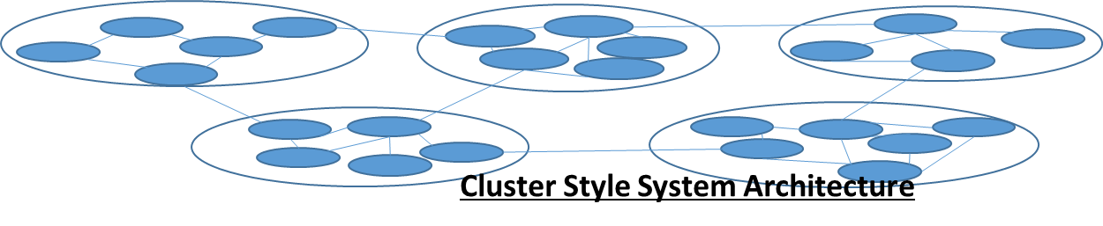
Intelligent Programming
Intelligent Programming is dynamic programming with a set of Intelligent components. In other words, an intelligent system consists of a set of intelligent components and the interconnections between them, namely,
Intelligent System ::= Dynamic Architecture + Intelligent Components

Slide 65
System - Structured definition
Structured: “Anything that has been put together in an organized, deliberate way can be described as structured.” -- Vocabulary.com
<System> ::= Architecture +) Components (Very-High-Level Programming)
<System> ::= Architecture + Static Components (Static Programming)
<System> ::= Dynamic Architecture + Active Components (Dynamic Programming)
<System> ::= Dynamic Architecture + [Intelligent] Components (Intelligent Programming)

Slide 66
Intelligent Component - Structured definition
Components
Static Components：Language constructions and their composition
Active Components : Processes or software defined things in running status
Intelligent Components : Active components with artificial or natural intelligent behind.

Slide 67
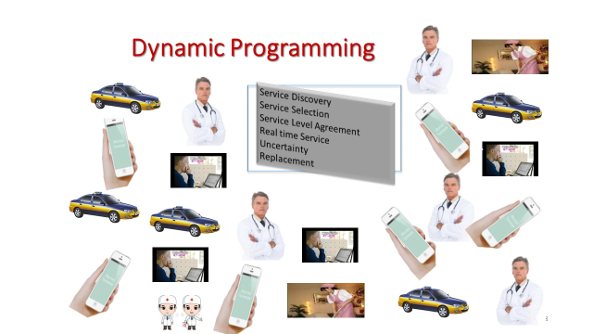
Q&A

Slide 68
Small Test: Dynamic Software Programming
What is dynamic software programming?
What is active component?
What is dynamic architecture？
What is the difference between active component and static component?
What is the difference between dynamic and static architecture?
What are the 7 features of dynamic software programming？
Do you think that a software process is an active component?
Do you think that a web service is an active component?
Does dynamic programming support very large-scale software reuse?
What is the relationship between software-defined everything and dynamic software programming?

Slide 69
Software Defined Things (Example)
Software Defined Thing is an abstraction of the thing, with combination of internet the object may be managed or manipulated via software. E.g.
Software-defined data center
Software-defined infrastructure
Software-defined mobile network
Software-defined networking
Software-defined projector
Software-defined radio
Software Defined Printer,
Software Defined Doctor
Software Defined Taxi
Software Defined Friends
Software Defined Meeting
Software Defined Computer
Software Defined Seattleite

Slide 70
Internet of Things (Examples)
The Internet of Things (IoT) describes the network of physical objects—“things”—that are embedded with sensors, software, and other technologies for the purpose of connecting and exchanging data with other devices and systems over the internet.[1][2][3][4]. [wiki]
Internet of home
Internet of restaurant
Internet of people
Internet of Taxi
Internet of University
Internet of Doctors
Internet of Courses
Internet of Animals
Internet of Shops
Internet of Games
Reference
Rouse, Margaret (2019). "internet of things (IoT)". IOT Agenda. Retrieved 14 August 2019.
^ Brown, Eric (20 September 2016). "21 Open Source Projects for IoT". Linux.com. Retrieved 23 October 2016.
^ "Internet of Things Global Standards Initiative". ITU. Retrieved 26 June 2015.
^ Hendricks, Drew. "The Trouble with the Internet of Things". London Datastore. Greater London Authority. Retrieved 10 August 2015.

Slide 71
Intelligent Software Development
Dynamic programming with a set of intelligent components and a network style architecture, resulting an intelligent system.
Intelligent Components refers to active components that perceive and respond to the world around. Intelligent refers to both natural intelligent, artificial intelligent and their combination, for example , the software defined robots, humans, animals, taxies and airplane.
Network Style Architecture
+ Intelligent Components
= Intelligent System

Slide 72
Appendix: Dynamic Programming
Haikuan Li, Zhanqiu Dong and Yuanrui Wei, “Dynamic Programming”, Computer Engineering Design, 1989-2

Slide 73
Appendix(I)：Dynamic Programming
所谓动态程序设计实质上是不要求所设计的结果一定具有封 闭性、再现性与顺序性这些静态程序的固有特性。这使我们自然想到“进程”,这个已经用了很久,近似于经典的概念。
动态程序设计是以进程为软件成分的进程程序设计,是主张应用与应用的具体实现相独立的程序设计。为适应客观变化的环境, 使软件具有一定的动态可适应性。这不仅是可行的, 而且近年来关于程序设计的研究工作已为这一技术的发展奠定了基础。
静态程序设计 完全避开客观演变的环境,在静态环境下应用静态程序。这种策略以限制软件应用的时间和空间为代价, 虽然可行,却不足以解决软件危机中所面临的问题。
李海宽 董占球 魏源瑞 “动态程序设计”《计算机工程设计>, 1989-2 。

Slide 74
动态程序设计Dynamic Programming
动态程序设计: 是以进程为软件成分(components)的进程程序设计。
进程通讯：对于进程的任意两次调用通讯,实际上是从一个一直前进的过程的两个不同点上去获取其运动中的结果或有关信息,而且一个进程可独立地接受外界影响。这便很难保证不同时间调用的一致性。
进程的独立性：进程的独立性使其不属于任何调用者私有并转而成为整个进程社会的成员。
随动等式: 类似于赋值语句,等号左边的量接受右边表达式的计算值。不同的是每当右边表达式中任何量的变化能使这一表达式的值发生变化, 则左边变量值将自动随着发生变化。
自由进程: 所谓自由进程是指那些不被任何应用宣布短期或长期雇用的进程或曾被雇用但因为被解雇而正处于“失业”状态的进程.自由进程都是可再用的
李海宽 董占球 魏源瑞 “动态程序设计”《计算机工程设计>, 1989-2 。

Slide 75
Appendix(II)： Other Definitions of Dynamic Programming
Dynamic Software Programming is a programming paradigm that emphasizes the dynamic behavior of a program, in contrast to static programming, where program behavior is fixed at compile time. It refers to a programming style in which a program can change its behavior at runtime based on input or conditions.
Dynamic programming techniques are widely used in a variety of applications, including artificial intelligence, web development, user interface design, and game development. They allow for more flexible and adaptable programs that can respond to changing conditions and user inputs.

Slide 76
Examples of dynamic programming (OpenAI）
Dynamic typing, where variables can change their type at runtime.
Dynamic dispatch, where a method or function call is resolved at runtime based on the actual type of the object or argument.
Dynamic memory allocation, where memory is allocated and deallocated at runtime.

Slide 77
dynamic programming languages:
Python: A high-level, interpreted language known for its simplicity and readability.
Ruby: A dynamically-typed language known for its elegant syntax and support for metaprogramming.
JavaScript: A scripting language widely used for web development and in building interactive web applications.
PHP: A server-side scripting language used for web development, often in combination with HTML, CSS, and JavaScript.
Perl: A high-level, interpreted language known for its regular expression processing and string manipulation capabilities.
Lisp: A family of programming languages that emphasize symbolic processing and code-as-data.
Smalltalk: An object-oriented programming language that was one of the first to implement dynamic dispatch and dynamic typing.

Slide 78
Dynamic Programming as Problem Solving Methods
Dynamic programming(动态规划) is often used to solve problems that have overlapping subproblems, such as finding the shortest path(最短路径) in a graph, computing the longest common subsequence(最长公共子串） of two strings, or solving the knapsack problem(背包问题}.
In computer science, dynamic programming is a technique for solving optimization problems by breaking down a complex problem into smaller subproblems, solving each subproblem once, and storing the solution to each subproblem in a cache (缓存) so that each subproblem is only solved once. The solutions to the subproblems are then combined to solve the original problem.
In operations research, dynamic programming is a more general term that refers to any method of solving sequential decision problems. In this context, dynamic programming encompasses techniques like Markov decision processes and stochastic dynamic programming(随机动态规划 ).

